Slide 1
Modeling and Analysis of AC Output Power Factor for Wireless Chargers in Electric Vehicles
Presented By 1.Name (VH no:6532………….. Reg.No 113014105010………………)
2.Name (VH no:6533………….. Reg.No 113014104025………………)
3.Name (VH no:6548…………. Reg.No 113014105033.………………)
Internal Guide: SENTHIL KUMAR.R
Name (professor & M.E.)
Department : EEE

Slide 2
Contents to presentation
Abstract
Existing System
Disadvantages
Block Diagram
Block Diagram Explanation
Advantages
Application
Referance

Slide 3
Abstract
Analysis of the output power factor before rectification on the receiver side for wireless chargers in electric vehicles. This power factor is usually regarded as unity i.e., the ac output voltage is in phase with the current.
However, the default unity power factor assumption is not accurate for output power derivation even at resonance frequency. The continuous conduction mode and discontinuous conduction mode are both analyzed.
An integrated LCC compensation topology is selected as the research object, and its analysis process can be readily extended to other common topologies.

Slide 4
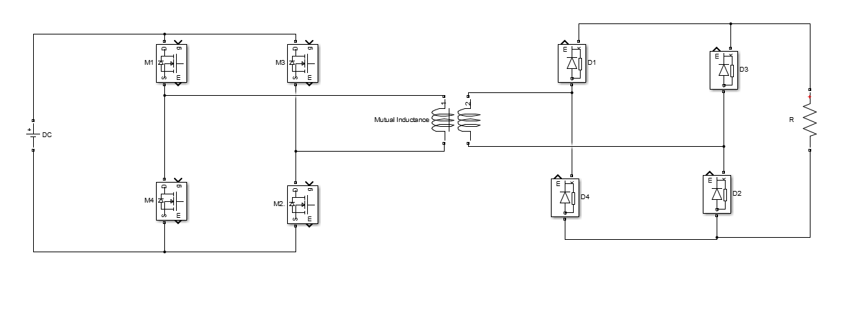
Existing System
The conventional circuit consists of input DC supply full bridge rectifier then the transmitting coil and receiving coil, then the full bridge rectifier circuit.
DISADVANTAGES
Ripple factor high due to diode rectifier
Single output
Low efficiency.

Slide 5
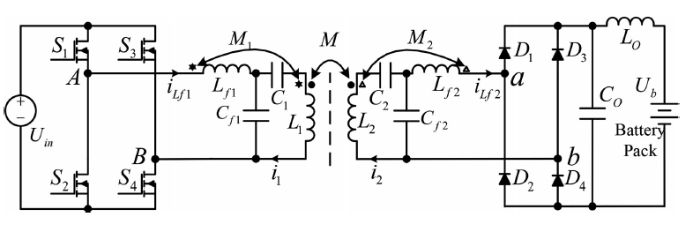
Proposed method
The transmitter side is comprised of a high frequency inverter, an LCC compensation network and a transmitter coil. The compensation network—C1 , Cf 1 , Lf 1 , and the coil L1—constitutes a compensation resonant circuit. The inverter with full bridge structure is composed of four power MOSFETS (S1 ∼ S4 ). The mutual inductances of Lf 1/L1 , Lf 2/L2 , and L1/L2 areM1 , M2 , and M, respectively

Slide 6
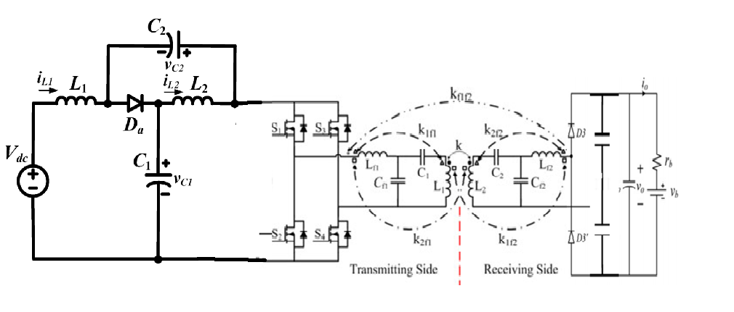
In the modified circuit Quazi Z source is added along with voltage doubler

Slide 7
Block Diagram
DC
Quazi Z SOURCE
FULLBRIDGE HIGH FREQUENCY INVERTER
TR
RE
LCC
VOLTAGE DOUBLER
LOAD
LCC
12V
GATE DRIVER
AMPLIFIER
5V
MICROCONTROLLER

Slide 8
BLOCK DIAGRAM EXPLANATION
MICROCONTROLLER PIC16F84A- PULSE GENERATION
AMPLIFIER 74244- TO AMPLIFY THE CURRENT GAIN
GATE DRIVER CIRCUIT FAN3972-DRIVE THE MOSFETS
5 AND 12V –POWER SUPPLY FOR CONTROLLER AND GATE DRIVERCIRCUIT

Slide 9
ADVANTAGES
High power conversion efficiency by adopting the ZVS technology.
z source advantage:
The voltage fed quazi z source includes all the advantages of Z source inverter like voltage buck and boost operation.
Voltage doubbler advantage
Voltage doubler, the output voltage which is double as that of the input voltage.Heavy and expensive step-up transformers can be replaced in some applications by this voltage doubler

Slide 10
APPLICATIONS
Electric vehicle applications.
Electronic portable devices.
Cell phones,
laptops & tablets
smart watches.
Aerial Vehicles and Solar Power Satellites.

Slide 11
REFERENCES
J. M. Miller, O. C. Onar, and M. Chinthavali, “Primary-side powerflow control of wireless power transfer for electric vehicle charging,”IEEE J. Emerg. Sel. Topics Power Electron., vol. 3, no. 1, pp. 147–162,Mar. 2015.
A. Khaligh and S. Dusmez, “Comprehensive topological analysis ofconductive and inductive charging solutions for plug-in electric vehicles,”IEEE Trans. Veh. Technol., vol. 61, no. 8, pp. 3475–3489, Oct.2012.
G. Buja, M. Bertoluzzo, and K. N. Mude, “Design and experimentationof WPT charger for electric city car,” IEEE Trans. Ind. Electron., vol. 62,no. 12, pp. 7436–7447, Dec. 2015.
U. K. Madawala and D. J. Thrimawithana, “A bidirectional inductivepower interface for electric vehicles in V2G systems,” IEEE Trans. Ind.Electron., vol. 58, no. 10, pp. 4789–4796, Oct. 2011.

